Slide 1
Smart Start
Paying for university
Thurs. June 20, 2024 – 7:00p.m. to 9:00p.m. EST
Sat. June 22, 2024 – 10:00a.m. to 12:00p.m. EST Mon. June 24, 2024 – 9:30a.m. to 11:30a.m. EST

Slide 2
The Partners
Supporting Departments
McMaster Student Union (MSU)
Housing / Off-Campus Living
Meal Plan
Parking Services
Bookstore
The Student Success Centre (SSC)
The Office of the Registrar (RO)
Mac’s Money Centre (MMC)
Panelists
Liz Maguire – Trust Fund Administrator, Aid & Awards –HOST / MODERATOR / STUDENT FINANCIALS
Victoria Scott – Administration Services Coordinator – MSU (McMaster Student Union) – SUPPLEMENTARY FEES
Declan Sweeney– VP Finance – MSU (McMaster Student Union) – SUPPLEMENTARY FEES
Ricki Wellstead– Student Loans & Award Officer– Aid & Awards (Bursary portfolio) (RO) – OSAP/BURSARIES/SCHOLARSHIPS/WORK-STUDY
Adam Moniz- Transition Program Coordinator – SSC - MAC 101

Slide 3
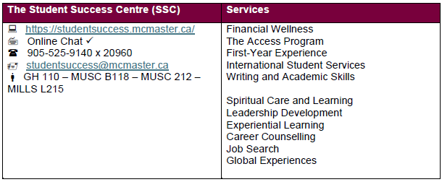
The Partners – (Student Resources - Workbook p13)
Main hub for student information and services
All academic
Financial
Aid & Awards / applications / requirements
Access and Processes
One-stop shop for student services
Our Student Service Professionals (SSPs) are always happy to help!

Slide 4
Smart Start Workbook
& Resource Guide
Link is in your email and in the chat.
Contact information
Enrolment & Financial Terms and Conditions
Explanations
Checklists
Budget worksheets
Dates and deadlines
Schedules
Links to websites and resources
Upcoming “don’t miss” info sessions /seminars

Slide 5
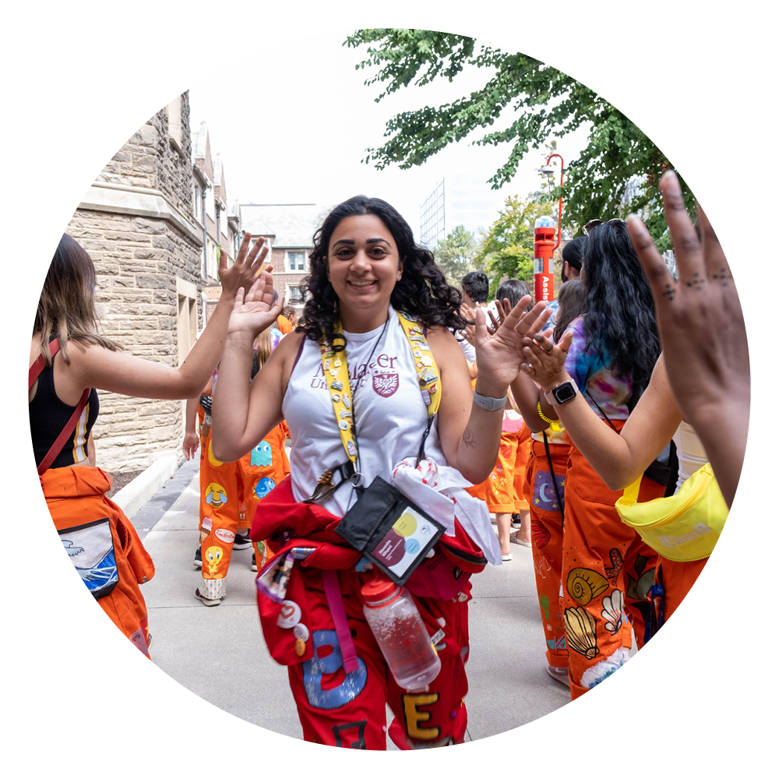
Agenda
New student overview
The summer finance checklist
Your Smart Start plan
Managing your student account
How to save money as a student
OSAP/scholarships/bursaries/work-study opportunities
Tips & helpful hints
Q&A

Slide 6
Lifeline
Your Mac undergrad years
Responsibility bridge
New role for parents/caregivers
Commitments
FIPPA
Misconceptions

Slide 7
Summer Checklist
(every summer)
Complete your OSAP app by June 30th
Enrol during your enrolment appointment
Aggressively set aside $ from summer job
Talk to your parents/caregivers about:
Their plan to contribute
Your R.E.S.P. (Registered Education Savings Plan)
Any scholarships from their workplaces
If you’re covered under their health and/or dental insurance plan (until when?)
Complete the General App in AwardSpring
(August)
Apply for external scholarships
Consider working part-time during school-apply
Watch for sales on personal items/school supplies
Start putting your budget down on paper

Slide 8
Meet Khaled…
He’s a first-year Commerce student
He has $2,000 in the bank from a summer job
His dad promised $3,000
He’s applied to OSAP
He applied for residence
Got a laptop from his friend for $300
He looked over the list of classes
He’s very excited and feels he is ready!
Khaled’s plan…
$5,000 + a laptop. OSAP will cover the rest, right?
His school costs only are estimated at: $27,764.41
His OSAP was assessed at: $12,000
Whoops! Now he must find the difference…

Slide 9
Khaled’s Smart Start plan
Expenses
Resources
Tuition & Supplementary Fees | $ 11,094.41
Books & Supplies | $ 1,500.00
Residence/Rent * | $ 8,350.00
Meal Plan/Groceries/Dining Out * | $ 5,320.00
Cell Phone/Cable/Internet * ($150x12) | $ 1,800.00
Other utilities * | $ 600.00
Clothing | $ 200.00
Entertainment & Personal * | $ 1,200.00
Uninsured Medical/Dental/Optical | $ 0.00
Unsubsidized Daycare * | $ 0.00
Transportation (gas/insurance/pass) * | $ 1,200.00
Travel (home for the holidays/vac) | $ 1000.00
Minimum Credit Card Payments * | $ 0.00
Other (tech expenses, buffer, etc.) | $ 500.00
Expenses Sub-total: | $ 32,764.41
Savings | $ 3,000.00
Bank Loan/ Line of Credit | $ 4,000.00
Parental Contribution | $ 3,500.00
McMaster Scholarships | $ 1,200.00
External Scholarships & Bursaries | $ 3,000.00
Full-Time OSAP (Loans & Grants) | $ 12,000.00
McMaster Dependent Bursary | $ 0.00
R.E.S.P. | $ 0.00
Monetary Gifts | $ 200.00
Gov. Income ODSP/CPP/Orphans Benefits | $ 0.00
Employment income during study period | $ 4,400.00
Other bursaries - AwardSpring application | $ 0.00
Other (garage sale, fundraising) | $ 750.00
Resources Sub-total: | $ 31,300.00
Don’t be Khaled!
Complete your Smart Start plan = no surprises!
Action/Solution
Projected his summer earnings and will save an extra $1,000 from job
Spoke to parents. They agreed to $500 more.
$1,200 in McMaster scholarships
$3,000 in external scholarships
Apply for the general bursary (February)
Work a few extra shifts this summer
Also keep him on 10 hrs/week during school
Secure a line of credit for $4,000

Slide 10
So, you have a deficit…
It’s okay! Take ownership and get resourceful
Adjust expenses – remain realistic – decide what’s important to you
Consider part-time work, living expenses, etc.
Apply for the McMaster General Bursary Program and scholarships
Investigate a Student Line of Credit – lending rates are lower, builds credit
Discuss with parents/caregivers/those invested in your future
The Registrar’s Office and Money Coaches at the Mac Money Centre are here to help!
Remember: future enrolment hinges on clearing unpaid balances

Slide 11
Supporting Departments / Tips
Rezlife
Off-Campus Housing
Hospitality Services
Campus Store
Parking Services
Wellness Centre
Bus Pass Presto Card
MSU

Slide 12
Financial Wellness Mental Wellness
Our Wellness Centre reports that students under financial stress have increased stress/anxiety levels. This can lead to unhealthy habits that impact academic success.
The Wellness Centre is free to access for students as part of your supplementary fees. Coverage is for 12 months.
Best way to be successful? Prepare!
September 3rd = hit the ground running
First goal: eliminate finances as a distraction
End goal: Eliminate all stressors that distract from your academics

Slide 13
Managing a surplus
Pay down credit cards, lines of credit, anything that’s costs money to hold a balance
Pay as much as possible toward your OSAP
Set aside money for next year
Get professional advice on appropriate investing
Focus on avoiding financial debt and stress
Plan a little “me time” or “down time” to relax and rejuvenate
Save big purchases and travel as a graduation gift to yourself

Slide 14
IMPORTANT!
Read BEFORE you enroll
Getting ready to enroll
Financial Term & Conditions to Enrollment
Financial General Information
Delinquent Accounts & Collection Policy
Links are in your Workbook
Meet your Academic Advisor
Learn your program requirements
Prepare early!

Slide 15
Payment Due Dates
Non/late payment by due dates are subject to:
Late payment fee
Monthly interest
Financial blocks: interim or full-service blocks

Slide 16
Managing your Student Account
Remember: it’s your responsibility to review your Account Summary regularly.
Make sure you understand all charges
Confirm all payments made have been received
All amounts owning are paid in full by the payment due dates for each term
You should also set up:
Online banking – pay McMaster as a bill
Direct Deposit – for easier refunds
Reminders for you to review your account
Regular review times with your parents/caregivers
Avoid interest charges – pay on time

Slide 17
Supplementary Fees
Provides campus services to all students
Enhances the student experience
Clickable link on Mosaic Account Summary
18+ units = MSU supplementary fee package
Mandatory packages assessed to all students
4 groups of fees - University, MSU, Non-University and Society
Health/Dental Insurance
HSR bus pass
PULSE gym membership
Wellness Centre
Opting-Out of health and/or dental
Who can?
When: Sept 1 – 30 only
How?
12-month coverage / access

Slide 18
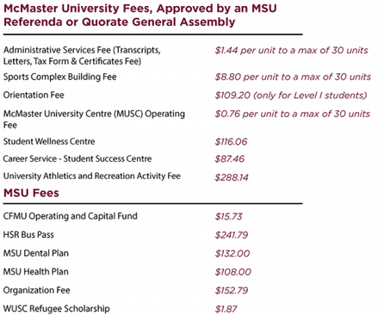
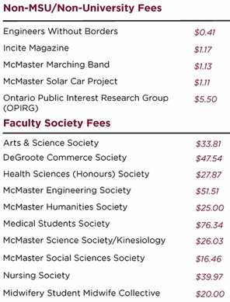
NOTE:
All fees illustrated are from
2023-2024.
Clubs
Employment
Food Collective Centre
msumcmaster.ca

Slide 19
Other items you may see in your Student Account
Bookstore
Residence
Awards
OSAP
Purchases
Deposit (credit)
(credits)
(credit)
Parking
Lab Fines
Equipment
Code of Conduct
Infractions
charges
Fine

Slide 20
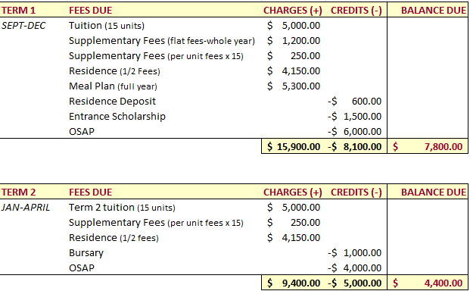
Paying your account with OSAP
ACCOUNT
OSAP
PAYMENT DUE DATES
Amounts used are rounded estimates for illustration purposes only and do not reflect actual values.

Slide 21
Payment Methods
Online banking
Adding McMaster as a bill
or
(through the student McMaster Mosaic portal)
https://www.higheredpoints.com/
https://registrar.mcmaster.ca/payment-methods//

Slide 22
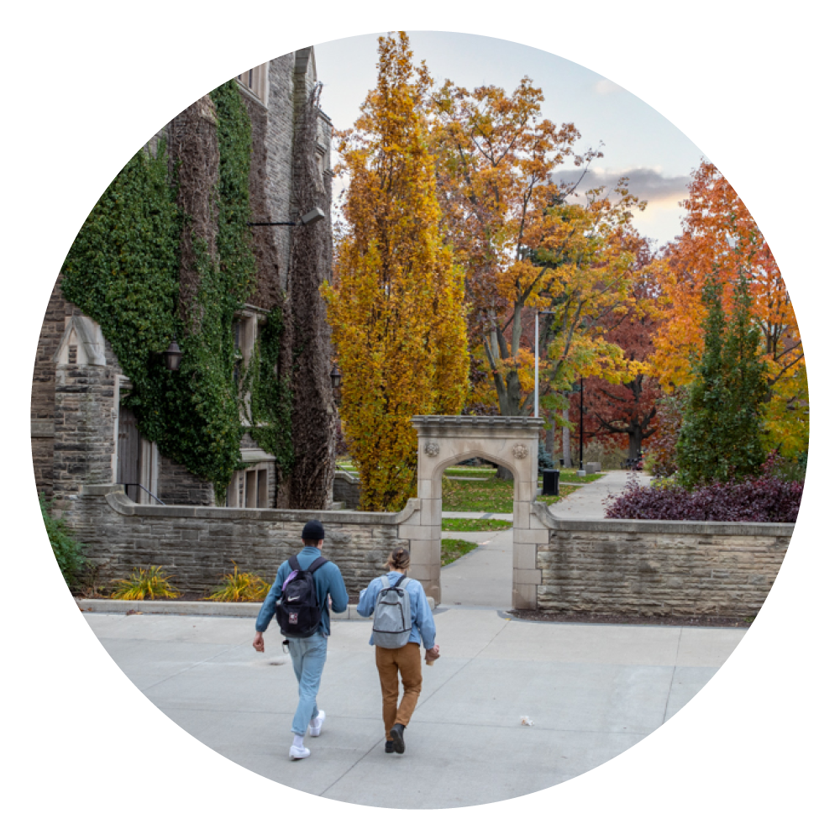
Dropped vs. Cancelled courses
Always talk to your academic advisor before deciding
Dropped courses:
Dropped before the add/drop date
Course tuition is deducted from your account
Per-unit supplementary fees are recalculated
Course is removed from your record
Can have financial implications (loss of scholarships, less OSAP, etc.)
Withdrawn / Cancelled courses:
Cancelled after the add/drop date
Course remains on your student record as “cancelled/withdrawn”
Subject to cancellation fees
Can have financial implications (loss of scholarship, reduced OSAP, loss of MSU services, etc.
Financial deadline does not equal academic deadlines

Slide 23
The Ontario Student Assistance Program offers:
Grants (non repayable)
Loans (repayable)
Available to full-time or part-time students
Apply online by recommended deadline: June 30th
Meant only to supplement your costs, not pay in full
Every student is assessed individually
Based on individual information supplied in the application.
OSAP

Slide 24
Based on merit (grades/leadership, community involvement, volunteerism, etc.)
Internal – from McMaster (automatic /by app)
Entrance (paid in Sept)
Incourse (paid in Sept)
Travel & Exchange (paid in April)
Application dates are on RO website
External – from outside organization
Anytime (usually early before study period)
All funds first applied to unpaid balances
External scholarships show as “Student Payment”
Scholarships

Slide 25
Based on financial need
For students who are OSAP-assessed
Complete the General App on AwardSpring
Automatically assessed or by application
Entrance
General
Travel & Exchange
When are bursaries paid?
Entrance: October
General: February
Funding is first applied to unpaid balances on your Student Account.
Bursaries

Slide 26
Based on both merit and financial need
For students who are OSAP-assessed
Paid out: December
Complete the General App on AwardSpring – look for your matches, complete additional applications
Funds are first paid toward any unpaid balance in your student account
Academic Grants

Slide 27
Provides immediate, short-term, one-time, financial relief due to unexpected expenses such as rent, bills, food (not tuition)
Expected that prior to applying for this grant, students will have exhausted all other sources of funding
How to apply? Contact Student Services via the online chat or visit GH 108 for drop-in service.
More info at: https://registrar.mcmaster.ca/aid-awards/emergency-financial-support/ ​
Emergency Funding

Slide 28
For students who are OSAP-assessed
Campus jobs - up to 10 hours/week
Range of around 1250 jobs on campus
Fall/Winter applications available in Mosaic (mid-August)
International undergraduate students with a valid study permit are eligible for the McMaster Work Program (no work permit required)
McMaster Work Program

Slide 29
Get free $$$ with
AwardSpring is McMaster’s one-stop shop for scholarships and bursaries.
STEP 1 – AUGUST 12 → - Complete/ submit the General Application and start getting matched to scholarships that match your eligibility.
STEP 2 - Watch for “Follow-Ups” to complete. It’s that easy!
Start your awards journey at: mcmaster.awardspring.ca

Slide 30
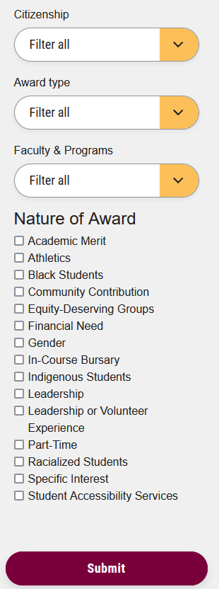
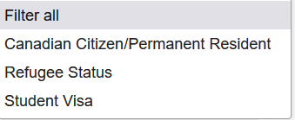
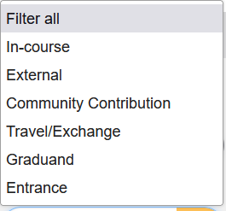
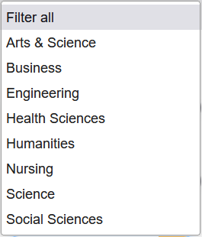
FUNDS
FINDER
Helps you search for awards that meet your needs and eligibility
Step 1: Search Funds Finder
Step 2: Complete the general application on AwardSpring
Step 3: Apply for General Bursary Program (if applicable)
Step 4: Receive your award

Slide 31
Student Success Centre
Mac’s Money Centre
Living on a Budget
Making ends meet
Money Coach
Taxes
Financial workshops
Financial Literacy Series & Events
Pop-Up Tables
visit OscarPlus!
1-on-1 financial guidance
Tax Clinics
Life After Mac
Credit & Debit
Financial Independence
Setting yourself up
Banking/Investing
Best practices
Email us at: money@mcmaster.ca

Slide 32
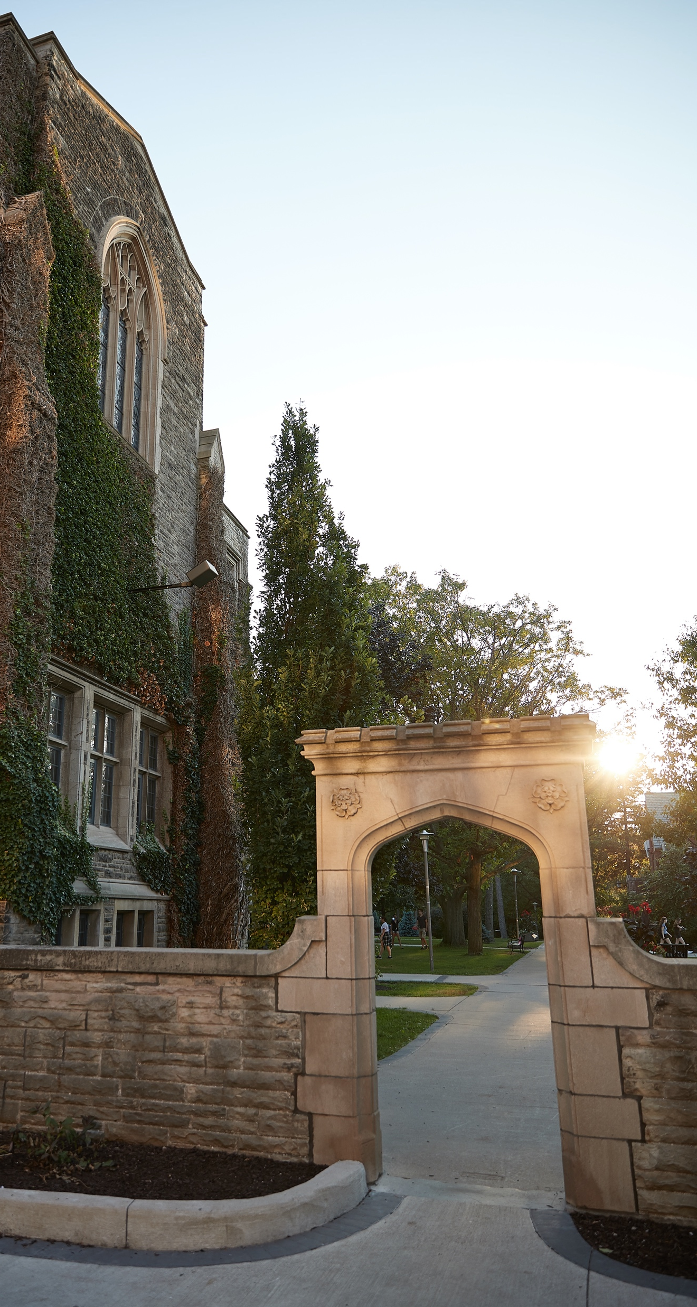
On-campus savings
Discounts at local restaurants, grocery stores, pharmacies and much more!
msumcmaster.ca/info/savings
Rezlife and MSU clothes swaps
MAPS Suit Drive (for students who need suits for interviews)
McMaster Used Textbook Sale (on Facebook)
Campus Club/Events with free meals
Participate in campus research studies (gift cards/money)
Thode Makerspace: Access and training to use tools, machinery such as 3-D printers, sewing machines, power tools
Watch large screen in MUSC (The Student Centre)

Slide 33
Online ways to save
Grocery coupons
Compare student cell phone plans
Student bank account comparison
Thrift stores - trending
Amazon Discount Textbooks
Facebook Marketplace
Kijiji
Apple Music / YouTube / Music / Spotify – all have student discounts
Wait for seasonal deals – Black Friday / Cyber Monday / Boxing Day

Slide 34
Needs vs. wants
Starbucks vs. buying a coffee maker and using a travel mug
Buying water vs. bringing your water bottle (Retro-fitted water stations)
MUSC microwave wall vs. buying lunch
Sobi bikes – create an account – choose a plan – very cheap and healthy
Bird-Ride (e-scooters) – day/week pass or pay-as-you-go
Stick to basics
Make thoughtful decisions
has the perfect one for you!
CLOSING THOUGHTS…..

Slide 35
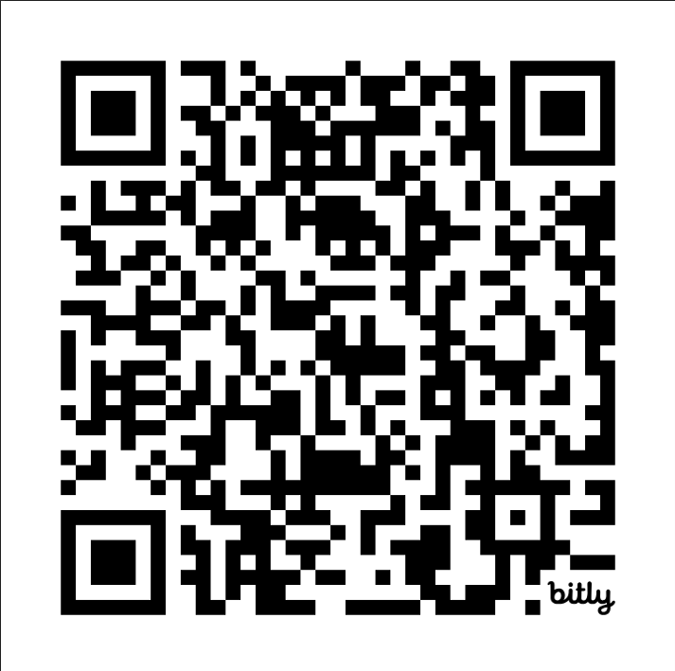
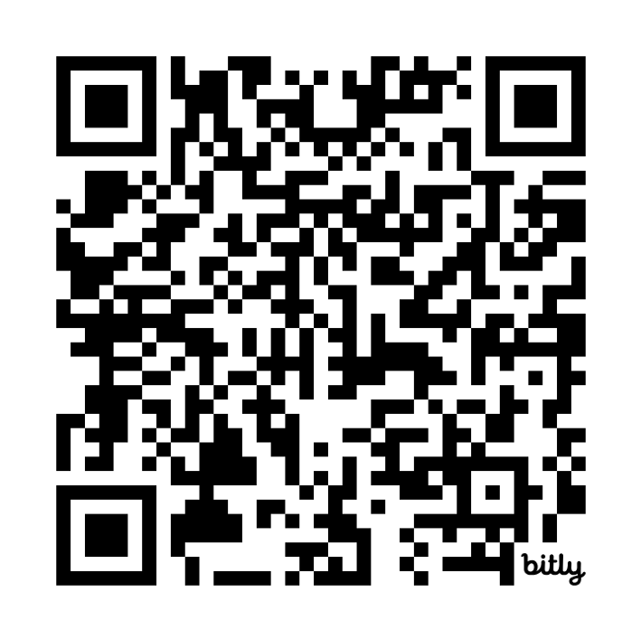
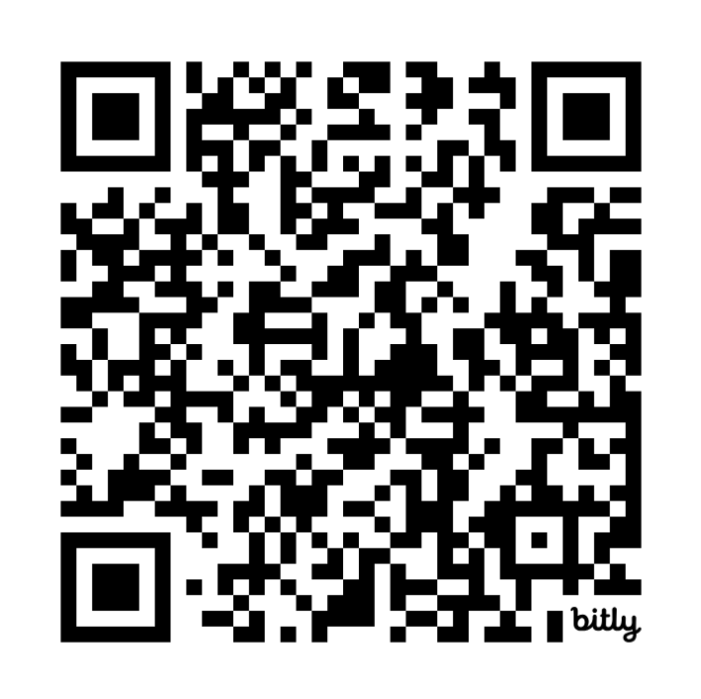
Thank you!
Residence Session
Sign up for Mac 101, your online orientation for everything from student life to tech help and much more!
Finance Session
Support for Students Session

Slide 36
Q&A
TITLE
Description

